Slide 1
Fiducian Group Limited Annual General Meeting Thursday 21 October 2021

Slide 2
Agenda
Welcome & Introduction
Discussion of the Financial Report
including the Executive Chairman’s address to Shareholders
Resolutions
Adoption of the Remuneration Report (Resolution 1)
Election of Director – Mr Frank Khouri (Resolution 2)
Appointment of KPMG as auditor (Resolution 3)
Issue of 90,000 share options to the Executive Chairman (Resolution 4)
Other Business and Q&A
Meeting Close

Slide 3
Welcome & Introduction
Virtual AGM Attendees
Executive Chairman – Mr Indy Singh
Directors – Mr Robert Bucknell, Mr Frank Khouri and Mr Sam Hallab
General Counsel & Company Secretary – Mr Paul Gubecka
Group Chief Financial Officer – Mr Rahul Guha
Group Auditor – Mr Andrew Reeves (KPMG)
Timing of Q&A
Voting – All by poll

Slide 4
Welcome & Introduction
Proxies cast
Resolution 1: Adoption of the Remuneration Report
Resolution 2: Election of Director – Mr Frank Khouri
For | Against | Abstain | Proxy’s discretion
6,020,416 | 55,668 | 2,575 | 104,100
For | Against | Abstain | Proxy’s discretion
16,069,577 | 1,242,015 | 15,218 | 114,800

Slide 5
Welcome & Introduction
Proxies cast
Resolution 3: Appointment of KPMG as auditor of the Company
Resolution 4: Issue 90,000 share options to the Executive Chairman
For | Against | Abstain | Proxy’s discretion
17,279,329 | 53,106 | 5,075 | 104,100
For | Against | Abstain | Proxy’s discretion
3,899,801 | 2,579,515 | 10,818,606 | 143,688

Slide 6
Agenda
Welcome & Introduction
Discussion of the Financial Report
including the Executive Chairman’s address to Shareholders
Resolutions
Adoption of the Remuneration Report (Resolution 1)
Election of Director – Mr Frank Khouri (Resolution 2)
Appointment of KPMG as auditor (Resolution 3)
Issue of 90,000 share options to the Executive Chairman (Resolution 4)
Other Business and Q&A
Meeting Close

Slide 7
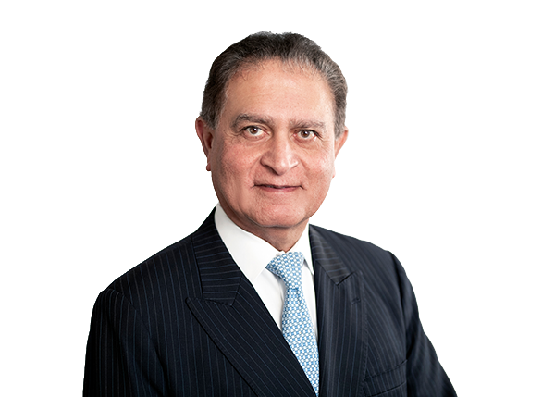
Discussion of the Financial Report
Executive Chairman’s Address to Shareholders
Mr Indy Singh

Slide 8
Resolutions
Resolution 1
To consider and if thought fit pass the following resolution as a non-binding ordinary resolution:
“That the remuneration report is adopted”

Slide 9
Resolutions
Resolution 2
To consider and if thought fit, pass the following resolution as an ordinary resolution:
“That Mr Frank Khouri, being a director retiring by rotation and being eligible for re-election, is re-elected as a director of the Company.”

Slide 10
Resolutions
Resolution 3
To consider and if thought fit, pass the following resolution as an ordinary resolution:
“That for the purposes of s327B of the Corporations Act 2001 (Cth) and for all other purposes, KPMG having been nominated by a shareholder of the Company and consenting in writing to act in the capacity of auditor of the Company, be appointed as auditor of the Company and that the Directors are authorised to fix the remuneration of the Auditor.”

Slide 11
Resolutions
Resolution 4
To consider and if thought fit, pass the following resolution as an ordinary resolution:
“That approval is given pursuant to ASX Listing Rule 10.14 and for all other purposes, to grant to Mr Indy Singh 90,000 share options to acquire ordinary shares in Fiducian in accordance with the terms of his employment agreement, at an exercise price of $6.47 per share, and to issue shares subscribed for pursuant to the options.”

Slide 12
Other Business and Q&A
Other Business
Q&A

Slide 13
Meeting Close
Thank you for attending the Annual General Meeting

Slide 14
Disclaimer
Information in this document and given in the presentation is of a general nature. It is not intended to be, nor does it, constitute financial, legal or tax advice. The information is given in good faith and, although care has been exercised in compiling it, Fiducian Services Pty Limited and the other members of the Fiducian Group (Fiducian) neither represent nor warrant that the information is free of errors, omissions or inaccuracies.
Fiducian takes no responsibility for losses suffered by a person relying on the information except for statutory liability that cannot be excluded.
Do not rely on this information without first seeking professional advice based on your own personal circumstances.
The information was prepared on 21 October 2021

